Slide 1
Middleware in Python
Lesson 11

Slide 2
Topics Covered
Flask Basics
URL Building and HTTP Methods
Templates
Cookies and Sessions in Flask
Message Flashing
Deployment using Flask

Slide 3
Flask Basics
Topic 01

Slide 4
Introduction to Flask
Flask is a web framework. It provides tools, libraries and technologies that allow users to build web applications.
Web application could be either some static web pages, or a blog, or a wiki, or commercial website.
Flask was developed by Armin Ronacher, who leads an international group of Python enthusiasts named Pocco.

Slide 5
Introduction to Flask (contd.)
Flask is a micro-framework.
Micro-framework is, generally, a framework with little to no dependencies on external libraries.
Pros: The framework is light, with little dependencies to keep up with and watch for security bugs.
Cons: Sometimes we will have to do more work to accomplish a task or add a lot of dependencies by adding plug-in.
Flask is primarily dependent on,
Werkzeug a WSGI utility library
jinja2 which is its template engine

Slide 6
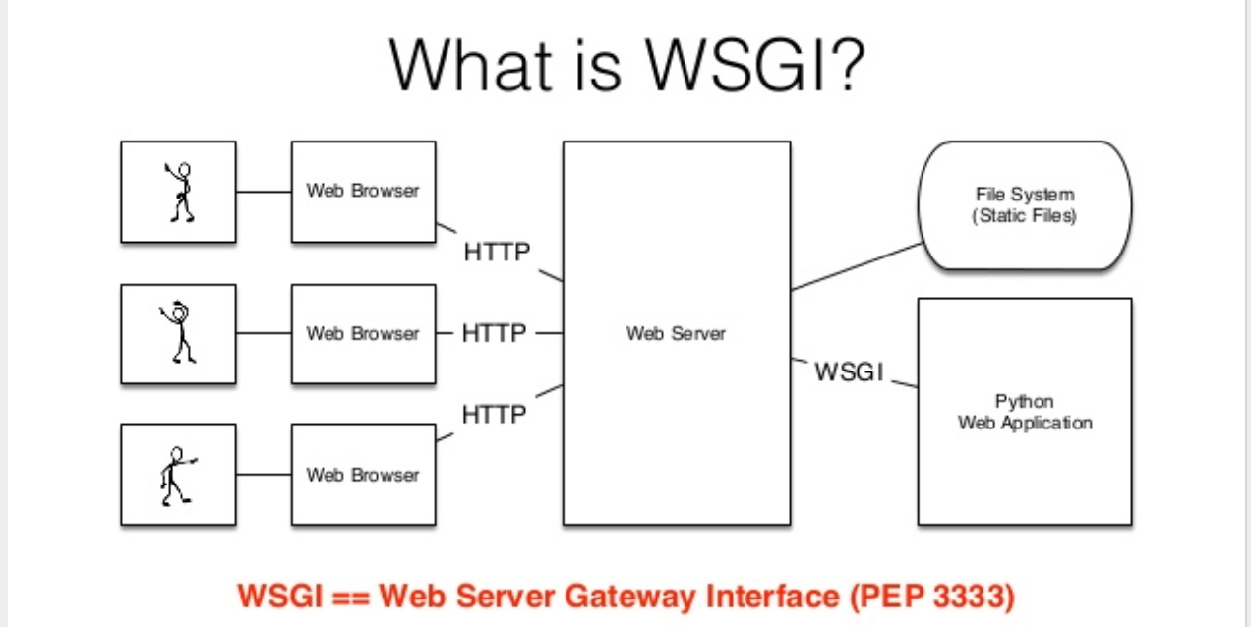
Introduction to Flask (contd.)
Source: https://www.slideshare.net/GrahamDumpleton/secrets-of-a-wsgi-master

Slide 7
Introduction to Flask (contd.)
Web Framework
Web Application Framework or simply Web Framework represents a collection of libraries and modules that enables a web application developer to write applications without having to bother about low-level details such as protocols, thread management etc.
Web Server Gateway Interface (WSGI)
(WSGI) has been adopted as a standard for Python web application development. WSGI is a specification for a universal interface between the web server and the web applications.

Slide 8
Introduction to Flask (contd.)
Werkzeug
It is a WSGI toolkit, which implements requests, response objects, and other utility functions. This enables building a web framework on top of it. The Flask framework uses Werkzeug as one of its bases.
Jinja2
Jinja2 is a popular templating engine for Python. A web templating system combines a template with a certain data source to render dynamic web pages.

Slide 9
Flask Installation
Before installing Flask, we need to setup a virtual environment
virtualenv is a virtual Python environment builder. It helps a user to create multiple Python environments side-by-side. Thereby, it can avoid compatibility issues between the different versions of the libraries.
The following command installs virtualenv
pip install virtualenv
Source: https://www.tutorialspoint.com/flask/flask_application.htm

Slide 10
Flask Installation
Install virtualenv for development environment
This command needs administrator privileges. Add sudo before pip on Linux/Mac OS. If you are on Windows, log in as Administrator. On Ubuntu virtualenv may be installed using its package manager.
sudo apt-get install virtualenv
Once installed, new virtual environment is created in a folder.
mkdir newproj
cd newproj
virtualenv venv

Slide 11
Flask Installation
To activate the corresponding virtual environment
On Linux/OS X
venv/bin/activate
On Windows
venv\scripts\activate
To install Flask in this virtual environment
pip install Flask
For system-wide installation, use the above command without the virtual environment setup

Slide 12
First Flask Program
In order to test the Flask installation, use the hello.py file
Go to the source directory and run this program from command line
python hello.py
Open a web browser and load the following URL
http:// 127.0.0.1:5000
To stop the program, press Ctrl+C on the command prompt

Slide 13
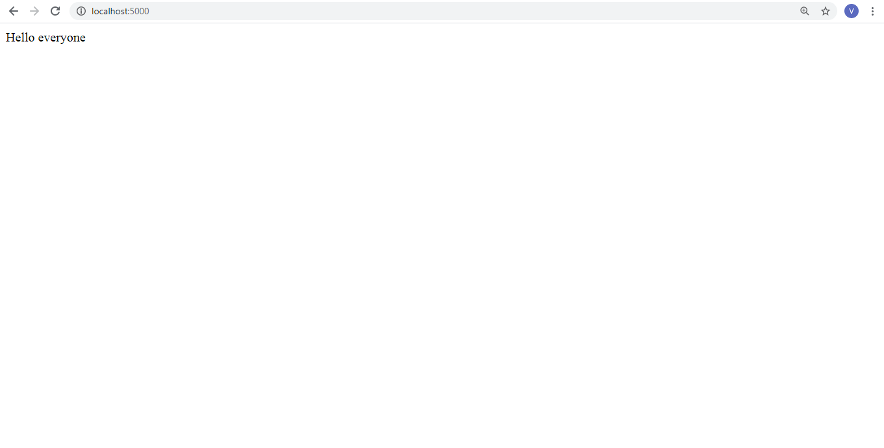
First Flask Program – Output in a Web Browser

Slide 14
First Flask Program: Deciphering
An object of Flask class is our WSGI application.
Flask constructor takes the name of current module (__name__) as argument.
The route() function is a decorator, which tells the application which URL should call the associated function.
app.route(rule, options)
The rule parameter represents URL binding with the function.
The options is a list of parameters to be forwarded to the underlying Rule object.

Slide 15
First Flask Program: Deciphering
Finally the run() method of Flask class runs the application on the local development server.
app.run(host, port, debug, options)

Slide 16
First Flask Program: Deciphering
Parameters | Description
host | Hostname to listen on. Defaults to 127.0.0.1 (local host). Set to ‘0.0.0.0’ to have server available externally
port | Defaults to 5000
debug | Defaults to false. If set to true, provides a debug information
options | To be forwarded to underlying Werkzeug server.

Slide 17
First Flask Program: Deciphering
Debug mode
A Flask application is started by calling the run() method. However, while the application is under development, it should be restarted manually for each change in the code. To avoid this inconvenience, enable debug support. The server will then reload itself if the code changes. It will also provide a useful debugger to track the errors if any, in the application.
The Debug mode is enabled by setting the debug property of the application object to True before running or passing the debug parameter to the run() method.
app.debug = True
app.run()
app.run(debug = True)

Slide 18
URL Building and HTTP Methods
Topic 02

Slide 19
URL Building
The url_for() function is very useful for dynamically building a URL for a specific function.
The function accepts the name of a function as first argument, and one or more keyword arguments, each corresponding to the variable part of URL.
Please go through the url_building.py program and run it on command line
python url_building.py
Once it is run successfully go to the browser and type
http://localhost:5000/user/admin

Slide 20
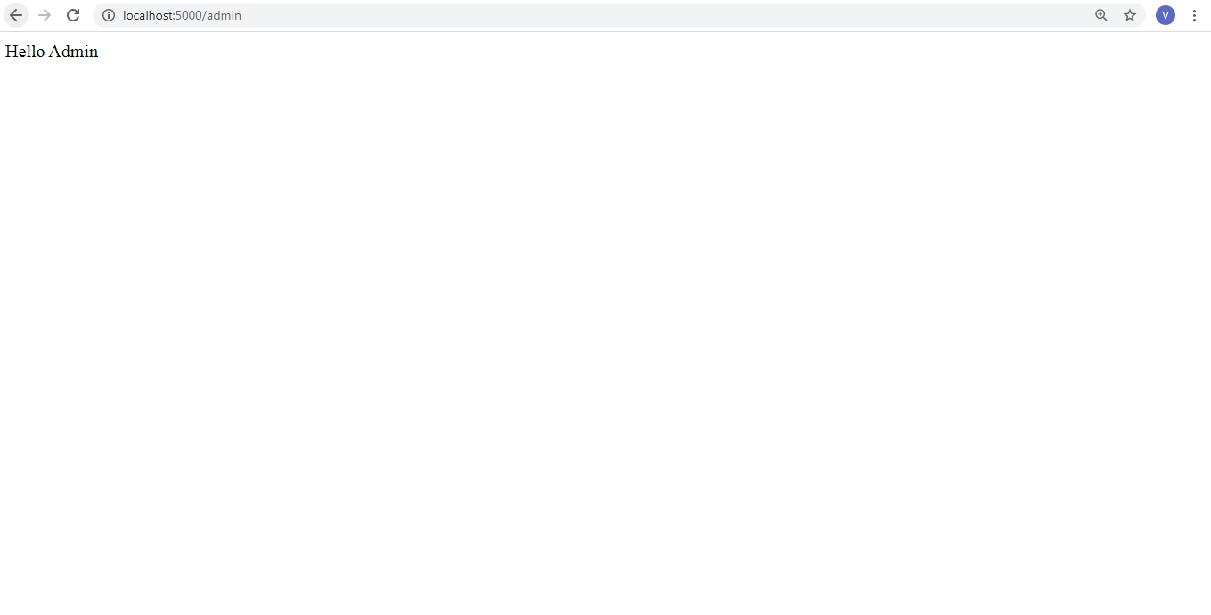
URL Building http://localhost:5000/user/admin

Slide 21
URL Building http://localhost:5000/user/admin
The url_building.py script has a function user(name) which accepts a value to its argument from the URL.
The User() function checks if an argument received matches ‘admin’ or not. If it matches, the application is redirected to the hello_admin() function using url_for(), otherwise to the hello_guest() function passing the received argument as guest parameter to it.

Slide 22
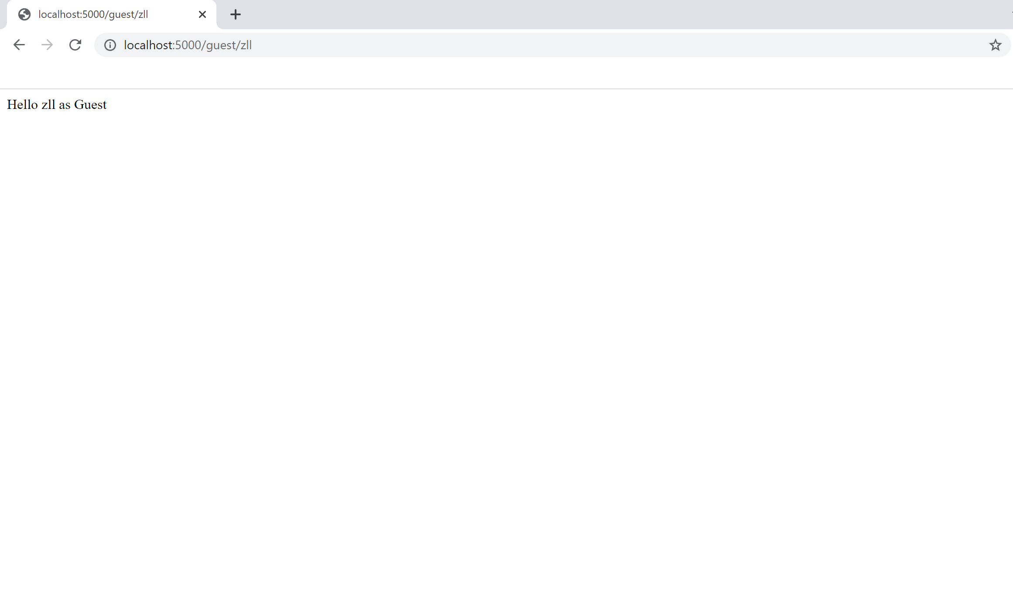
URL Building http://localhost:5000/user/zll

Slide 23
HTTP Methods
Http protocol is the foundation of data communication for the world wide web (www).
Different methods of data retrieval from specified URL are defined in this protocol.
Methods | Description
GET | Sends data in unencrypted form to the server. Most common method.
HEAD | Same as GET, but without response body
POST | Used to send HTML form data to server. Data received by POST method is not cached by server.
PUT | Replaces all current representations of the target resource with the uploaded content.
DELETE | Removes all current representations of the target resource given by a URL

Slide 24
HTTP Methods (contd.)
By default, the Flask route responds to the GET requests. However, this preference can be altered by providing methods argument to route() decorator.
For the POST method in URL routing, create an HTML form and use the POST method to send form data to a URL.
See the html file named login.html.
Now run http_method.py.

Slide 25
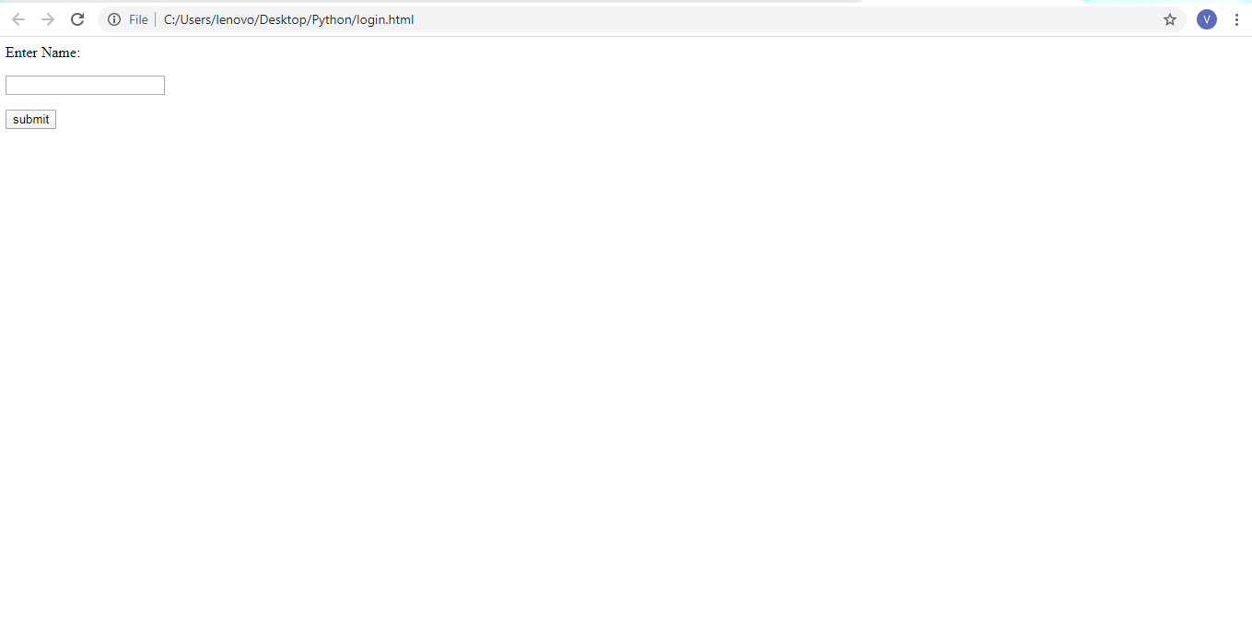
HTTP Methods (contd.)
After the development server starts running, open login.html in the browser.

Slide 26

HTTP Methods (contd.)
Enter name in the text field and click Submit.

Slide 27
HTTP Methods (contd.)
Form data is POSTed to the URL in action clause of form tag.
http://localhost/login is mapped to the login() function.
Since the server has received data by POST method, value of ‘nm’ parameter obtained from the form data is obtained by −
user = request.form['nm']
It is passed to ‘/success’ URL as variable part. The browser displays a welcome message in the window.

Slide 28
Templates
Topic 03

Slide 29
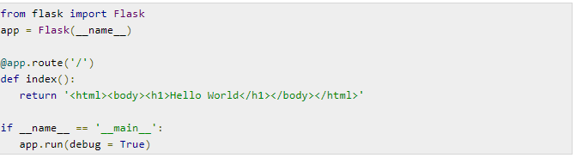
Templates: Why do We Need?
We can return HTML from a function that is bound to a certain URL
See the script tem1.py script
The hello() function renders ”Hello World” with <h1> tag.

Slide 30
Templates: Why do We Need?
To generate HTML content from Python is cumbersome
Consider if instead of sending “Hello World” we need to send “Hello <User>”, where <User> is the input provided by the end user.
In presence of variable data, conditional or loop based output we would require frequent escaping from HTML to Python and back.
We need templates to handle dynamically generated HTML

Slide 31
Templates: What are they?
The term ‘web templating system’ refers to designing an HTML script in which the variable data can be inserted dynamically.
A web template contains HTML syntax with interspersed placeholders for variables and expressions (e.g. Python expressions) which are replaced by values when the template is rendered.

Slide 32
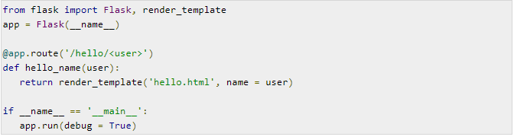
Templates: Jinja2
Jinja2 is a template engine used with Flask
The render_html() function of Jinja2 supports rendering of HTML files
We need following folder structure to use Jinja2
<Application Folder>
Hello.py # this is the script file
Templates # folder with the HTML files
hello.html
Run the sample tem2.py file

Slide 33
Templates: Jinja2
Run the sample tem2.py file
When the development server runs, open the browser window and type the URL
http://localhost:5000/hello/ZLL
The variable part of URL is inserted at {{name}} placeholder

Slide 34
Cookies and Sessions in Flask
Topic 04

Slide 35
Cookies
A cookie is file stored on a client’s computer in the form of a text file.
Its purpose is to remember and track data pertaining to a client’s website usage for better visitor experience and site statistics.
A Request object contains a cookie’s attribute. It is a dictionary object of all the cookie variables and their corresponding values, a client has transmitted. In addition to it, a cookie also stores its expiry time, path and domain name of the site.

Slide 36
Cookies: Writing/Reading in Flask
Writing Cookies
In Flask, cookies are set on response object
Invoke make_response() function to get the response object from return value of a view function.
Invoke the set_cookie() function of response object to store a cookie.
Reading Cookies
The get() method of request.cookies attribute is used to read a cookie.

Slide 37
Cookies: Demo
Run the development server (cookies_example.py)
Point the web-browser to http://localhost:5000
We get a form to enter <userID>
Now, login by entering any <userID>
This will set the cookie with <userID> in the response object
User will be redirected to the readcookie.html page with a link to read the cookie.
Click on the link to read the cookie value and display the same in the browser

Slide 38
Cookie based Sessions: What is it?
A session is initiated when a user logs in and is typically terminated when the user logs out.
Data pertaining to a user, for a given session is only available to the user for that session across multiple requests.

Slide 39
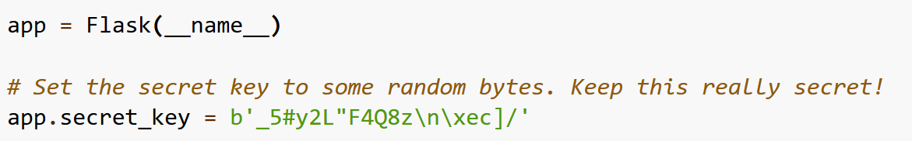
Cookie based Sessions
The session object is a dictionary containing key-value pairs of session variables and associated values
Like cookies, the session data is also stored on the client
To set a ‘username’ in the session object
session[‘username’] = ’zll’
To release a session variable use the pop() method
session.pop('username', None)
Flask will serialize the session object into a cookie. Set the app.secret_key

Slide 40
Cookie based Sessions: Demo
Run the development server (session_example.py)
Point the web-browser to http://localhost:5000
We get the message “You are not logged in”
Now, login with any username http://localhost:5000/login
This will store the username in the session object
User will be redirected to the index page with the message “Logged in as <username>”
Now, logout http://localhost:5000/logout
This will remove the username from the session object and user will be redirected to the index page with the message “You are not logged in”

Slide 41
Message Flashing
Topic 05

Slide 42
Message Flashing
In a GUI application we need to provide feedback to the user about the interaction
This can be achieved through messages
Flask makes it easy to generate such messages

Slide 43
Message Flashing (contd.)
A Flask module contains flash() method. It passes the message to the next request, which generally is a template.
flash(message, category)
message parameter is the actual message to be flashed.
category parameter is optional. It can be either ‘error’, ‘info’ or ‘warning’.

Slide 44
Message Flashing (contd.)
In order to extract messages, template calls get_flashed_messages().
get_flashed_messages(with_categories, category_filter)
Both the parameters are optional. The first parameter is a tuple if received messages are having category.
The second parameter is useful to display only specific messages.

Slide 45
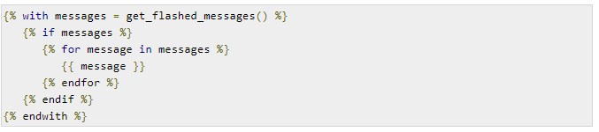
Message Flashing (contd.)
The following code snippet flashes the received messages in a template.

Slide 46
Message Flashing: Demo
Run the development server (flask_for_message.py)
Login with username (admin) and password (admin)
Following message will be flashed
“Hello admin, you were successfully logged in. Happy browsing!”
If incorrect username or password is provided then an error message is displayed!

Slide 47
Deployment using Flask
Topic 06

Slide 48
Deployment
For production environments, the web application needs to be deployed on a real web server
Flask can be easily deployed on popular Cloud Platforms such as Google Cloud Platform (GCP), Amazon Web Services (AWZ), Azure, etc.
We can also deploy Flask applications with Apache with mod_wsgi

Slide 49
Deployment (contd.) mod_wsgi
Assumption: Apache is already installed
mod_wsgi is an Apache module that provides a WSGI compliant interface for hosting Python based web applications on Apache server.
Install
pip install mod_wsgi
To verify that the installation was successful, run the mod_wsgi-express script with the start-server command
mod_wsgi-express start-server

Slide 50
Deployment (contd.) mod_wsgi
This will start up Apache/mod_wsgi on port 8000. You can then verify that the installation worked by pointing your browser at
http://localhost:8000/

Slide 51
Deployment: Creating .wsgi file
There should be a yourapplication.wsgi file. This file contains the code mod_wsgi, which executes on startup to get the application object. For most applications, the following file should be sufficient −
from yourapplication import app as application
Make sure that your application and all the libraries that are in use are on the python load path.

Slide 52
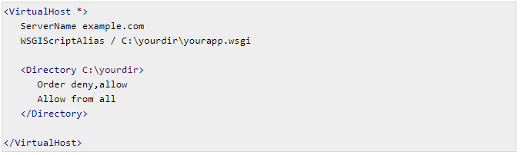
Deployment: Configuring Apache
need to tell mod_wsgi, the location of your application.

Slide 53
Deployment: Standalone WSGI Containers
There are many popular servers written in Python that are WSGI HTTP server.
Gunicorn
Tornado
Gevent
Twisted Web

Slide 54
Practice Questions
Create a web calculator with Flask.

Slide 55
References
https://www.tutorialspoint.com/flask
https://flask.palletsprojects.com/en/1.1.x/quickstart/
https://www.wisdomjobs.com/e-university/flask-tutorial-1355/flask-overview-17110.html

Slide 56

Queries?

